Slide 1
Improving Knowledge Extraction from LLMs for Task Learning through Agent Analysis (AAAI-24)
James Kirk, Robert Wray, Peter Lindes, John Laird
james.kirk@cic.iqmri.org
44th Soar Workshop
May 29, 2024

Slide 2
Cognitive Agents Often Need to Acquire Knowledge
LLMs?
Can Language Models be an effective, reliable source of knowledge for agents?

Slide 3
Outline
Integrating Soar with large language models (LLMs)
Prompting for task knowledge (baseline)
Embodied requirements
STARS learning process
Demonstration
Results and conclusion

Slide 4


CA Integration of LLMs
Symbolic Long-Term Memories
Procedural
Semantic
Episodic
Reinforcement
Learning
Chunking
Semantic
Learning
Episodic
Learning
Symbolic Working Memory
Tidy…cup
prompt
“What should I do?”
LLM API
Search for solution
question
response
“goal is…”
answer
Spatial Visual System
“Pick up…”
Human
Object-based continuous metric space
GPT
Perception
Action
External Environment
4
Integrating Diverse Knowledge Sources for Online One-shot Learning of Novel Tasks https://arxiv.org/abs/2208.09554

Slide 5
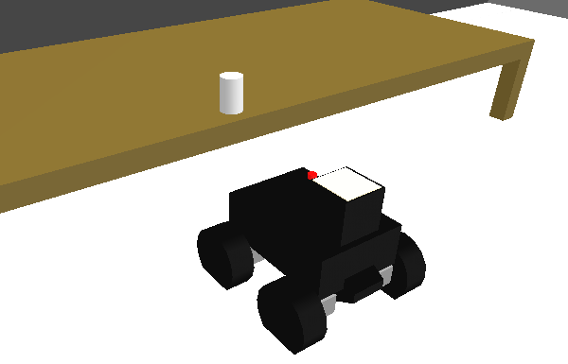
Prompting For Task knowledge (Template-Based prompting)
(EXAMPLES) (TASK) Task name: deliver package. Task context: I am in
mailroom. Aware of package addressed to Gary, package is in mailroom. Steps:
1. Pick up package addressed to Gary
2. Go to Gary's office
3. Put package onto desk in Gary's office
(RESULT)The goal is that the package is in Gary's office(END RESULT)
(END TASK)(END EXAMPLES)
(TASK) Task name: ?task. Task context: I am in ?location. Aware of ?object
?object-location. Steps:
1.
(TASK) Task name: tidy kitchen. Task context: I am in kitchen. Aware of
paper cup on table. Steps:
Pick up paper cup
2. Put paper cup in trash can
(RESULT)The goal is that the paper cup is in trash can(END RESULT)
CA
LLM

Slide 6
Embodied Learning Requirements
Responses retrieved from LLM for embodied agents must be:
Interpretable: Agent must be able to parse and interpret response using its NLP capabilities. AI agents typically lack human-level language capabilities.
Groundable to Situation: Objects, relations, and features referenced in LLM response must be perceivable and groundable by the agent.
Compatible with Affordances & Embodiment: LLMs, trained on a large corpus describing human activities, will (generally) generate responses conforming with human embodiment and affordances, which may differ from robot’s (e.g., a single arm)
Matched to Human Expectations: Users will have individual expectations about how tasks should be performed and what constitutes appropriate goals/behaviors.
Viable

Slide 7
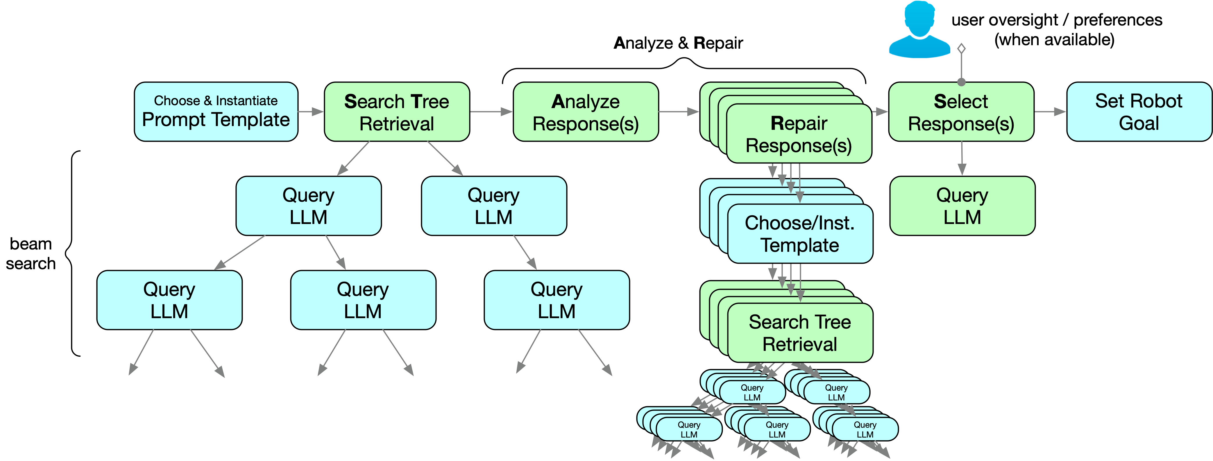
Improve retrieval with STARS:
Search Tree: retrieve a breadth of high-probability responses using beam search
Analysis and Repair: evaluate and repair knowledge mismatches through internal simulation, knowledge analysis, and re-prompting
Selection: prompt LLM to select from viable candidates given context

Slide 8
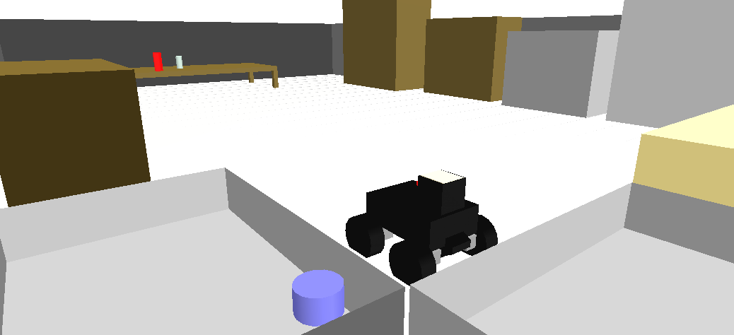
Analysis and Repair
LLM initial response:
The goal is that the ceramic-bowl is in the dish rack and the dish rack is in the cabinet.
Knowledge sources for Analysis of Mismatches
1
Language
2
Situation
3
Affordances/Embodiment
NLP Parser,
Semantic Memory
Environment grounding
Environment,
Semantic Memory
Analyze via internal simulation:
(Robot simulates learning from response to proactively identify issues)
1. Parse response and evaluate for language mismatches, unknown terms
2. Ground referents to environment, identify ungrounded refs: “cabinet”
3. Analyze if achievable given affordances ‘dish rack is in…’ ➜ rack must be moved search affordances ➜ not grabbable
dish rack
Detected mismatches:
The goal is that the ceramic-bowl is in the dish rack and the dish rack is in the cabinet.
ceramic-bowl
Repair prompts:
…No. Cannot see a cabinet.
...No. Dish rack is not grabbable.

Slide 9
Repair Search Tree
Prompt | Task name: tidy kitchen. Task context: I am in kitchen. Aware of apple-core on table. (RESULT)
Response(s)
No. No cannot see a cabinet.
No. Bin cannot be closed.
The goal is that the apple-core in the bin.
The goal is that the apple-core is in the cabinet.
The goal is that the apple-core is in the bin and the bin is closed.
The goal is that the apple-core is in the sink.
The goal is that the apple-core is in the bin. (DUPLICATE)
No. Unknown word rubbish.
The goal is that the apple-core is in the trash.
The goal is that the apple-core is in the rubbish bin.
Viable Responses
Re-prompt Repair

Slide 10
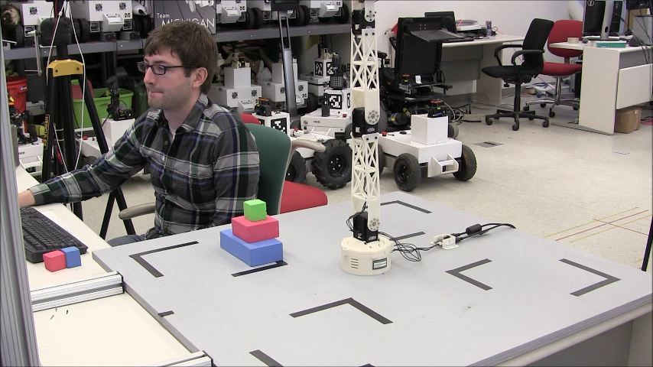
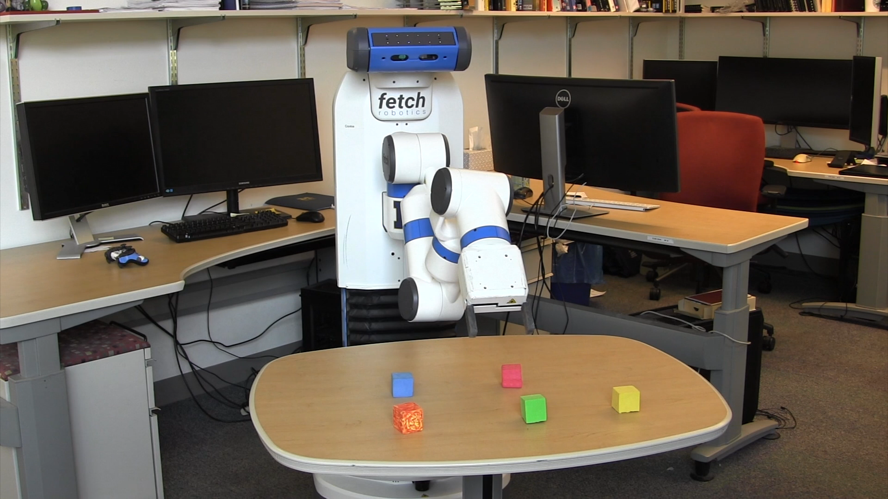
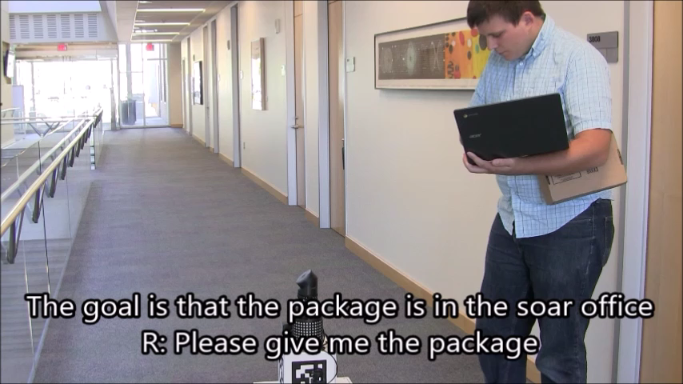
Application: Interactive Task Learning
Agents learn from interactive instruction in real-time
Learn all aspects of a task
Emphasize interaction via natural language, gestures, etc.
Real-time, online, one-shot learning
Accumulate knowledge across tasks
Evaluated on ITL agent implemented in Soar (over 3 tasks)
Embodied in 4 robot platforms; 4 simulators
Knowledge implements language comprehension, interaction, learning, and task execution strategy
Learns mobile robot office tasks and >60 games/puzzles
Mininger, A. & Laird J. E. (2018). Interactively Learning a Blend of Goal-Based and Procedural Tasks, AAAI-2018.
Kirk, J. R. & Laird, J. E. (2019). Learning Hierarchical Symbolic Representations to Support Interactive Task Learning and Knowledge Transfer. IJCAI-2019.

Slide 11
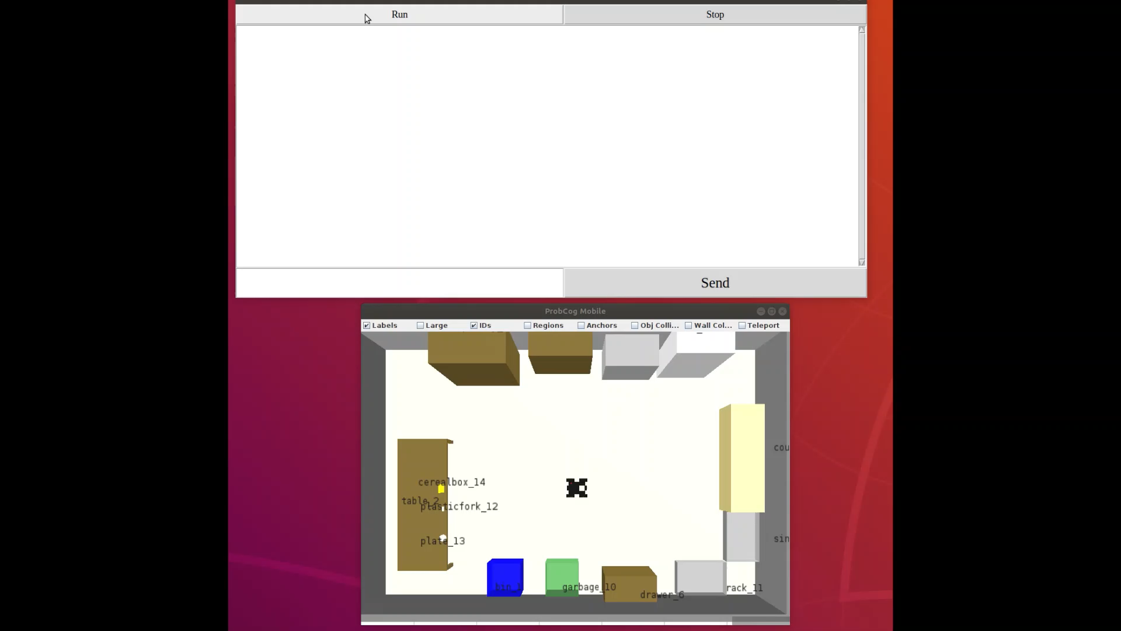

Slide 12
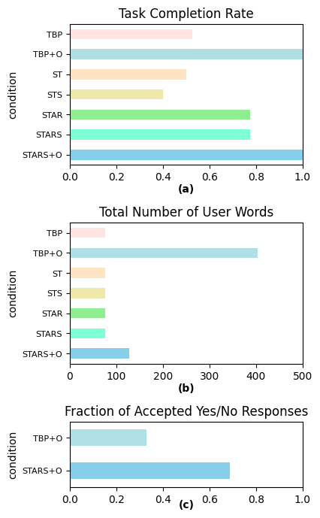
Improved Performance with STARS
Tidy Kitchen Task
Baseline (TBP): % Task completion
Tidy kitchen: 52%
Organize Office: 36%
Store groceries: 67%
STARS without oversight: % Task completion
Tidy kitchen: 77%
Organize Office: 93%
Store groceries: 94%
STARS with oversight: 100% task completion
~70% reduction in user effort (tidy kitchen)
User effort shifts from providing goal descriptions to confirmation (yes/no) of LLM provided goals
12

Slide 13
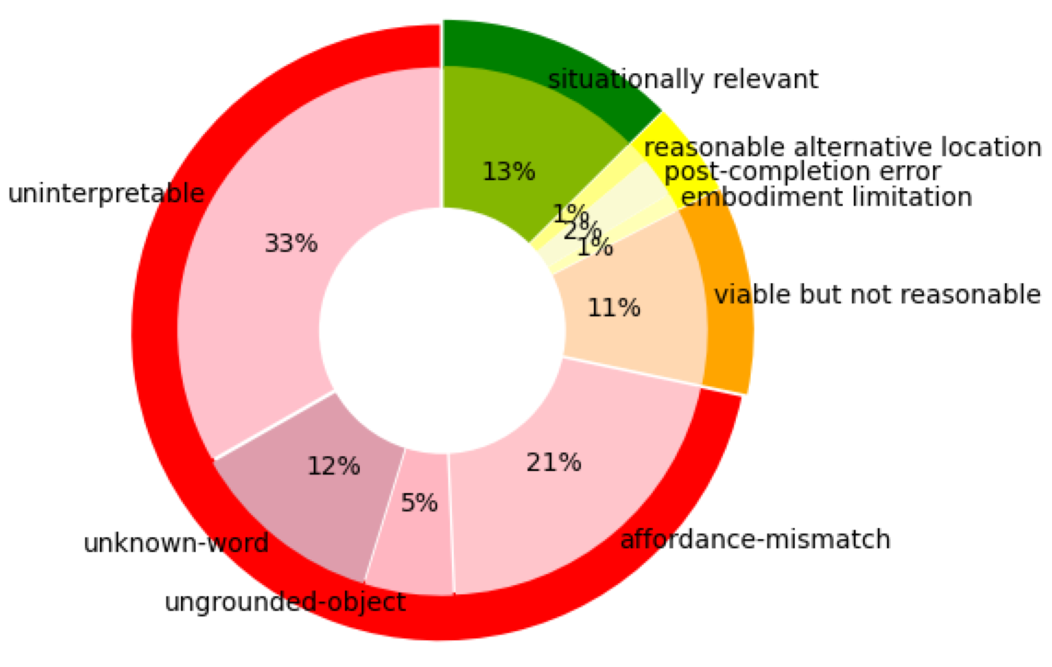
LLM Response Quality
In experiments, most responses retrieved from the LLM were not viable (~70%)
Agent analyzes to determine category of response to focus on viable responses
Supports that analysis is necessary for reliable knowledge extraction
Categorization of all responses retrieved for learning to “tidy kitchen”

Slide 14
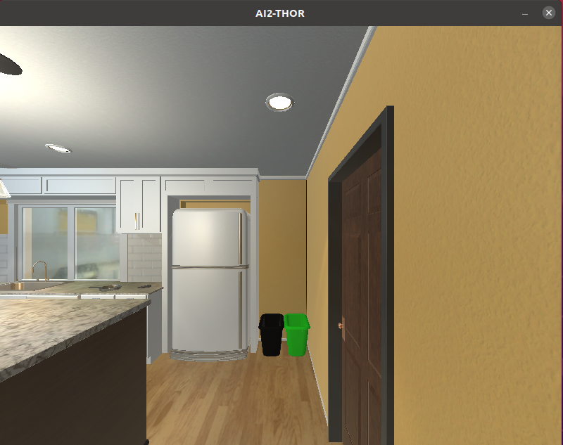
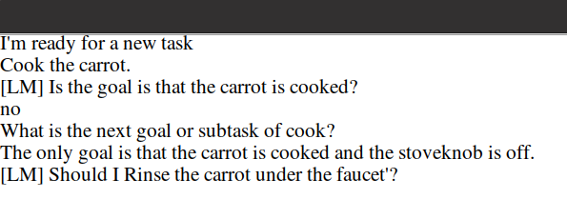
Recent Extensions to STARS
Learning different types of tasks knowledge with AI2Thor and STARS
Actions and subtasks (e.g., cook, rinse, place)
When search fails (e.g., no action models)
Learning grounding knowledge
“The goal is that all recyclables are in the recycling bin.”
Prompt for recyclable objects
empty metal can, plastic soda bottle
Retrieve and learn recyclable grounding definition(s):
If the material of the can is metal and it is empty then it is a recyclable.

Slide 15
Conclusion
Issues with LLMs (hallucinations, relevancy, etc.) can limit utility as a knowledge source, particularly for embodied agents
STARS ‘agentic’ approach of retrieving, analyzing, and repairing of breadth of LLM responses can help make LLMs a reliable knowledge source for learning
Cognitive agent provides context & verification to align LLM responses with learning requirements
In task learning experiments, STARS improves task performance and reduces required human oversight
Future work
Evaluate STARS on different learning targets and task environments
Explore improvements to LLM Selection via the use of additional context

Slide 16


Nuggets & Coal
Nuggets
Coal
STARS improves task completion and reduces the required oversight for ITL
‘Agentic’ approach enables proactive analysis & repair of a breadth of responses to align with embodied learning requirements
Cog. Arch. are well suited for these agentic LLM approaches and combining multiple sources of knowledge and reasoning
STARS has now been used in many tasks and enviroments, and for learning different kinds of knowledge
Currently limited by use with ITL agent to learning only from goal, action, and grounding descriptions
No experiments yet for STARS work on grounding and action learning
Would like to test STARS on a wider range of tasks, domains, and knowledge
Project ending… Looking for next source of funding!

Slide 17
Acknowledgements
This work was supported by the Office of Naval Research, contract N00014-21-1-2369. The views and conclusions contained in this document are those of the authors and should not be interpreted as representing the official policies, either expressed or implied, of the Department of Defense or Office of Naval Research. The U.S. Government is authorized to reproduce and distribute reprints for Government purposes notwithstanding any copyright notation hereon.

Slide 18
Questions?

Slide 19
Extra SLIDES

Slide 20
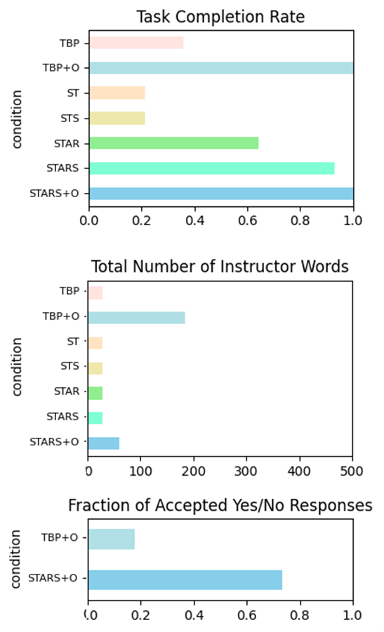
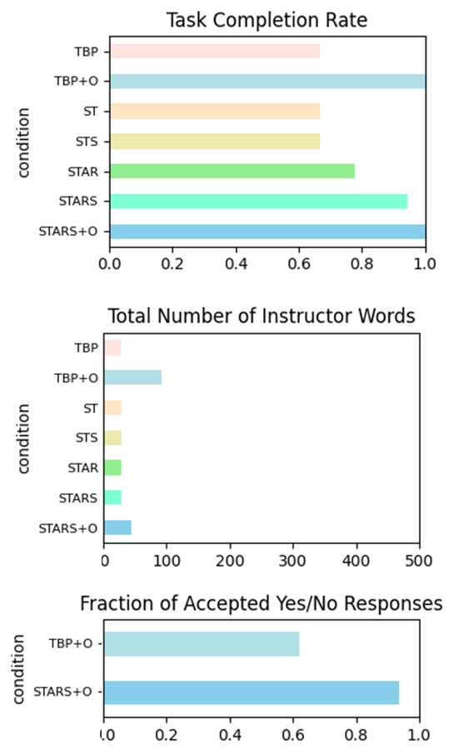
Organize Office & Store Groceries
20

Slide 21

Center for Integrated Cognition
Mission
The mission of the Center for Integrated Cognition (CIC) is to be a world leader in AI research that combines multiple reasoning and learning methods and applies them across a variety of domains, drawing inspiration from how people think and learn.
Our goal is to fill key gaps in AI basic research by creating systems that sense and act; reason; plan; represent, remember, use, and create knowledge; interact with language; and learn robustly and flexibly from their experiences with the world, interactions with other agents, and their own internal reasoning.
We will also create accompanying tools and infrastructure to encourage and nurture a new generation of integrated cognitive systems.
integratedcognition.ai
Organization
Non-profit research center (established Mar 2021)
Soft-money: Funding from government & industry
Basic research on complete (end-to-end) systems
Distributed organization headquartered in Ann Arbor
The CIC is a division of the IQM Research Institute (IQMRI), a 501.3.C (non-profit) corporation.

Slide 22
Strengths and Limitations
Cognitive Architectures (CA)
Large Language Models (LLM)
Established approach for sophisticated agents
Supports multiple sources of knowledge, including memories & experience
Explicable knowledge representations
Integrates embodied reactivity, complex reasoning, planning, metacognition, online learning, human interaction, internal simulation…
Limitations:
Difficult & expensive to acquire new task knowledge
Typically, challenging to exploit big data
Pretrained on a large corpus of text
State of art results for many NL tasks
Continual improvement (significant on-going investment)
Potential vast source of (latent) knowledge
Limitations:
Hallucinations; can generate incorrect, irrelevant, or unsafe responses
Lacks grounded context of environment, embodiment
Difficult to use/ground extracted knowledge
No permanent online learning or adaptation
How can they address each other’s limitations?

Slide 23
Exploit CA⬌LLM synergy
LLM➞CA
LLM provides large source of diverse task knowledge CA can use
LLM provides NL capabilities that mitigate need for sophisticated CA NLP
CA➞LLM
CA supports verification of LLM responses through multi-step reasoning and multiple knowledge sources
CA provides high-level context required to construct high quality prompts
CA supports interpretation and grounding of LLM responses
CA + LLM
CA provides capabilities that LLMs lack (e.g., verification, testing, grounding)
CA can make LLMs more practical, reliable, & usable
LLMs make it cheaper and faster for CA to acquire new task knowledge

